Slide 1
Portal Frontend Development
18 August 2020
Jakub Grosz and Jiri Majer (ELI)

Slide 2
Outline
Update on current state - technologies + structure
Questions and challenges
Search
Integration with backend
Original Analysis
Development roadmap

Slide 3
Update on current state - technologies
React
Rebass - themeui, styled-system, styled-components
allows a creation of highly scalable non-opinionated UI system
no actual ui system now, only basic preparations
SWR React Hooks for data fetching with support for caching
Sessions handling using OIDC (github login)
custom implementation following security best practices

Slide 4
Update on current state - structure
Completely rebuilt code base - streamlined structure, optimization, best practices
~ less like sandbox more like a production ready app
joint development should be possible now
Jiri is less ashamed of his code and actually regularly commits
Demo - overview of current functionality and code base organisation

Slide 5
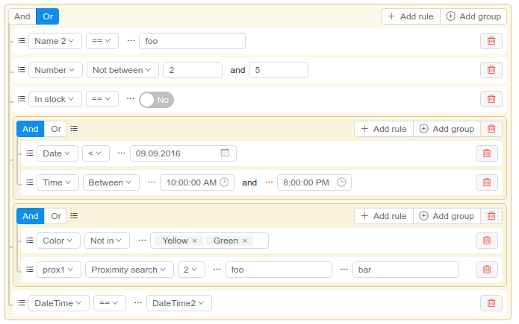
Questions and challenges
How to approach Search?
Query builder programmatically generated as Search Api seems infinitely complex
Search api should provide 'available filter resource'
We aim for something like this in terms of functionality but so much different in terms of ui that we need to build our own from scratch (UI inspiration: EOSC Marketplace, CERN Opendata)
‘steal’ the query building logic
help us on this one

Slide 6
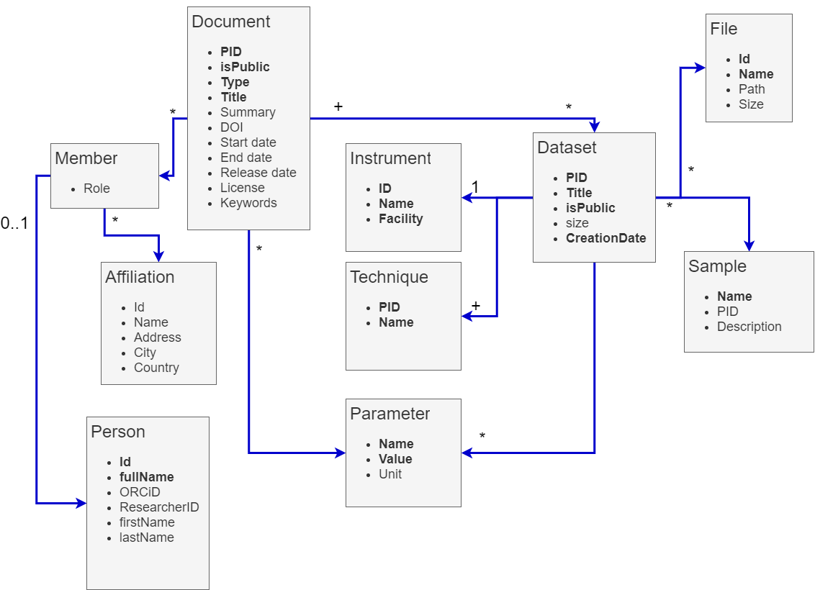
What is the scope of search UI/query builder?

Slide 7
Questions and challenges
How to approach Search?
If searching ‘nested’ data, should this be reflected/highlighted in Document page?
e.g. user’s query is based only on dataset’s parameters
should we be returning Document as the primary resource and highlighting the searched nested dataset?
should the UI change to dataset-only view?

Slide 8
Questions and challenges
Documents relationships
something we have discussed with WP3
are documents going to be grouped into higher level objects? or just referenced?
proposal, experiment and so on might be grouped to “project”(?)
schematic interactive timeline/graph?

Slide 9
Questions and challenges
Integration with PaNOSC Portal backend services
multi-dataset environment
is this something that will be supported in the near future?
api? post/delete: /instances/instance_id/dataset/datset_id
single dataset per environment only
some facilities will only support this approach?

Slide 10
Questions and challenges
How to implement original analysis + original environment?
We think this is very valuable feature for both scientific and public users and make it truly open science
no support in related services (at least to our knowledge)
please help us make this happen

Slide 11
Development roadmap
Related Milestones
October 2020 - Prototype implementation for portal
we are positive we will deliver
March 2021 - Launch Remote Desktop and Jupyter analysis from Portal
November 2021 - Demonstrator prototype completed
November 2022 - Publicly accessible demonstrator

Slide 12
Development roadmap
Short-term implementation goals - October 2020
Implementation of well-organised, reusable UI components
Prototype integration with backend services
Development and implementation of advanced search and filtering
Development and implementation of user dashboard

Slide 13
Development roadmap
Longer-term implementation goals
Development and integration of UI with all key services
Implementation of solutions and UI for management of documents, datasets, users, quotas, etc.
Integration of additional tools: chat, visualization, notifications???

Slide 14
Collaboration on frontend development
https://github.com/panosc-portal/frontend
Please join the development of either specific part such as search or dashboard, or general development of the frontend and integration with backend services
Who can collaborate?
Shall we restart frontend bi-weekly calls?

Slide 15
Thank you
jakub.grosz@eli-beams.eu jiri.majer@eli-beams.eu

